Slide 1
Host transcriptional response to SARS-Cov2 by Sex and Age
Ekpereka Amutaigwe, Credo Casmil, Dollina Dodani, Aditi Nallan
March 30th, 2022

Slide 2

Outline
Background
Description of dataset
Data exploration and manipulation
RNA-Seq
GO analysis
Machine learning
Conclusion

Slide 3
Background
SARS-CoV2 has shown a wide range of clinical manifestations among different population groups
Clinically, COVID-19 cases tend to be more severe for older adults and males
Lieberman el al. (Plos Biology 2020) examined host response gene expression across infection status, viral load, age, and sex among 430 individuals with PCR-confirmed SARS-CoV-2 and 54 negative controls.
Their study mainly examined gene expression differences associated with Viral load but did not report these differences for Age and Sex.

Slide 4
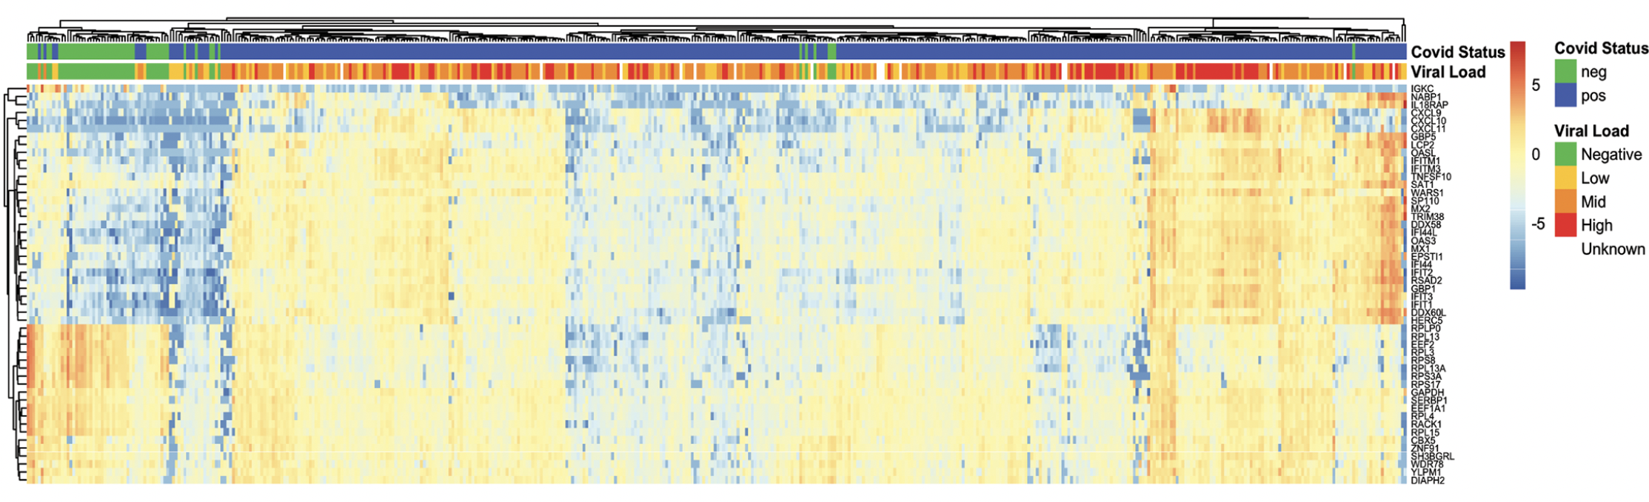
Figure from Lieberman et al. (Plos Biology 2020) paper
Clustering of samples based on 50 genes with the lowest adjusted p-value. Log2 fold changes relative to gene mean are displayed by color.

Slide 5
Specific research questions
What genes are significantly differentially expressed between the two groups (healthy and infected) while accounting for factors such as age and sex?
Are the significantly differentially expressed genes directly connected to immune response?
Could we leverage the information from the differentially expressed genes to predict the infection status of an individual?

Slide 6
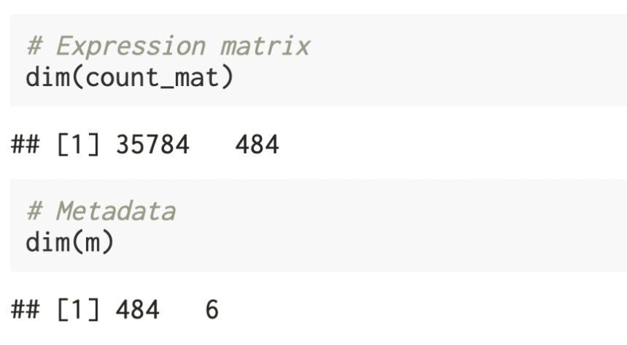
Dataset
Obtained from Lieberman et al. (Plos Biology 2020) paper.
This data was obtained in two separate files-
Main data file: expression values - one per gene, per sample ( G genes x N samples)
Metadata file: several covariates/experimental design variables for each sample ( N samples x P covariates). This file was modified to retain only the columns of interest- Sample, Age, Sex, Batch, Viral load and Sars test result.

Slide 7
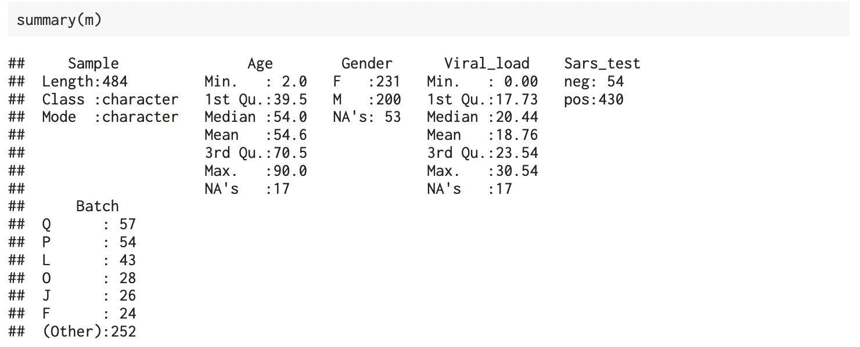
Metadata

Slide 8
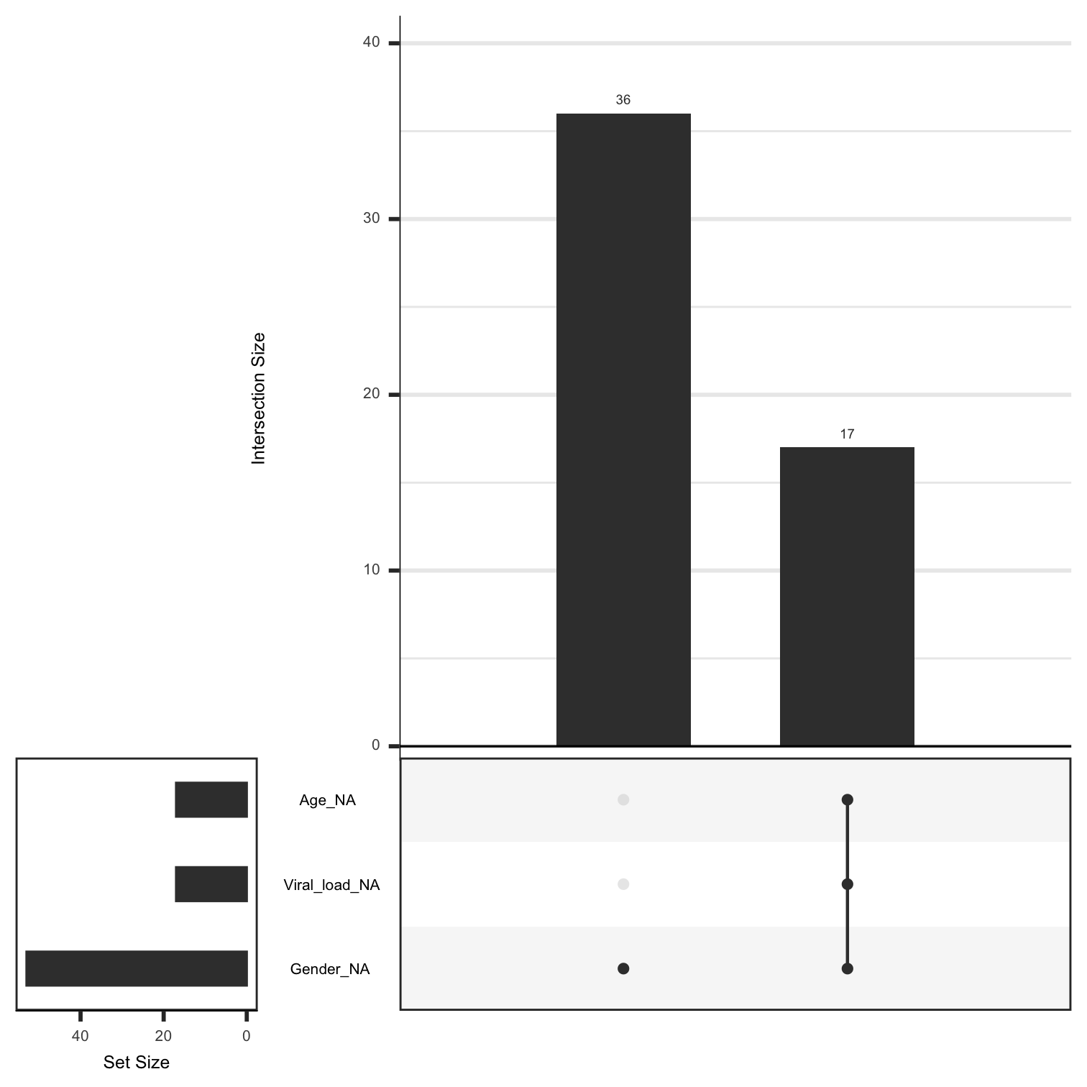
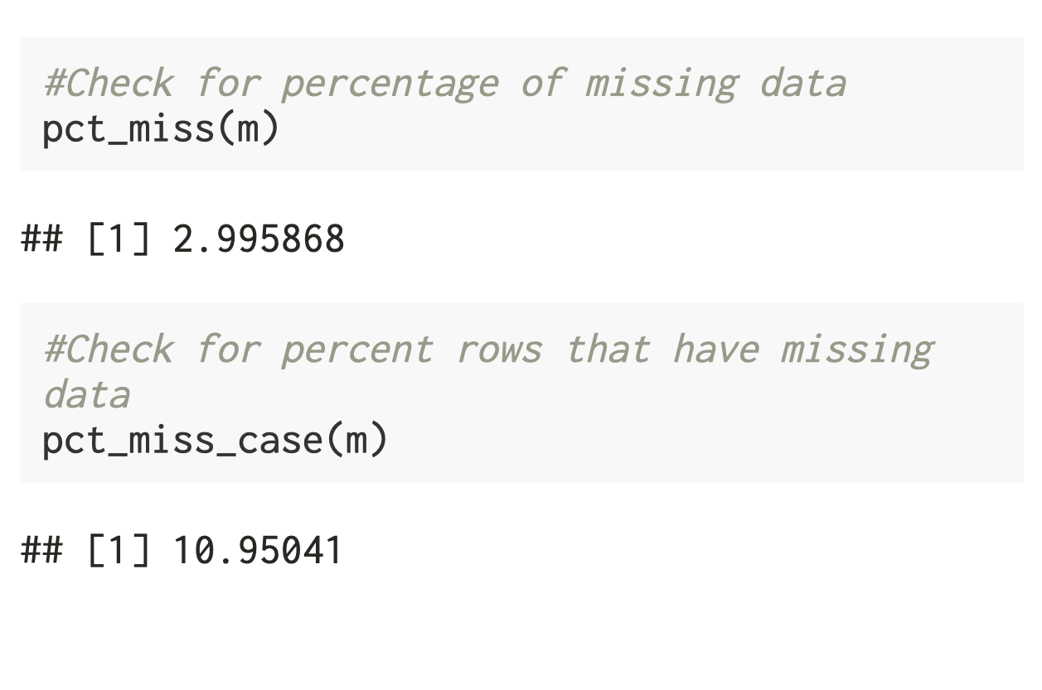
Visualization of missing data

Slide 9
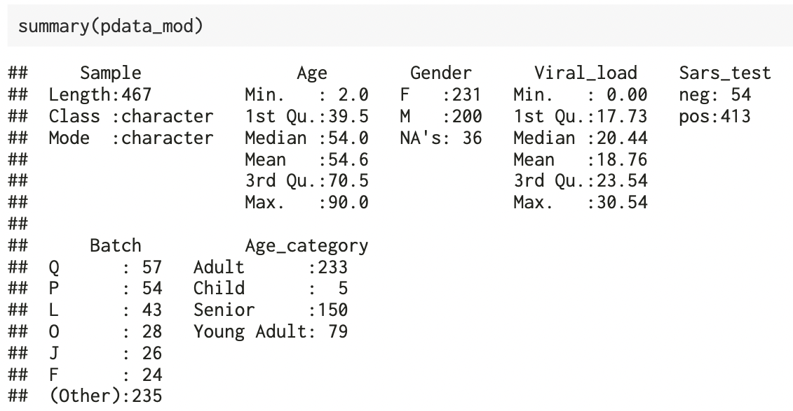
Data Manipulations
Removed 17 samples from the study that did not have any associated metadata as observed previously.
Added a new column to the sample metadata that groups the recorded ages into four categories of Child (<18), Young Adult (18 - 35), Adult (35 - 65) and Senior (>65)

Slide 10
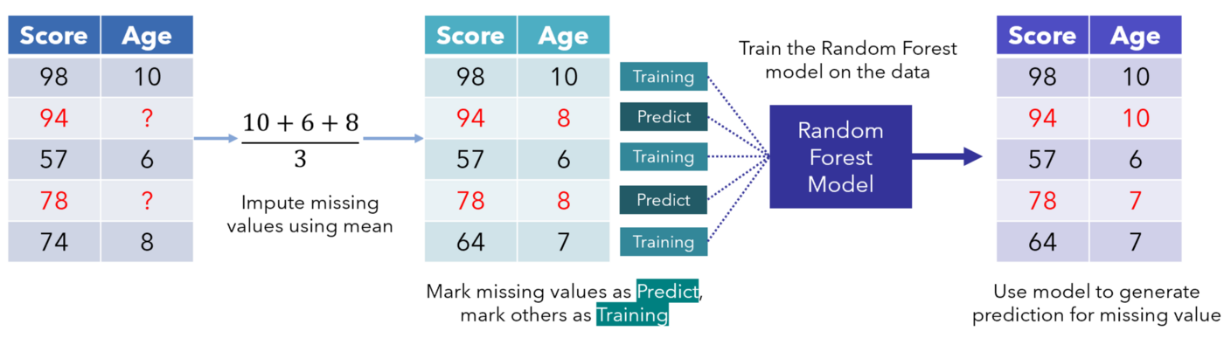
Data Imputation
MissForest is a random forest imputation algorithm for missing data, implemented in R in the missForest() package.
Advantages:
Can be applied to mixed data types
Robust to noisy data
Disadvantages:
Imputation time increases with the number of observations, predictors and missing values
Missing data is imputed in each run- problematic in some production environments

Slide 11
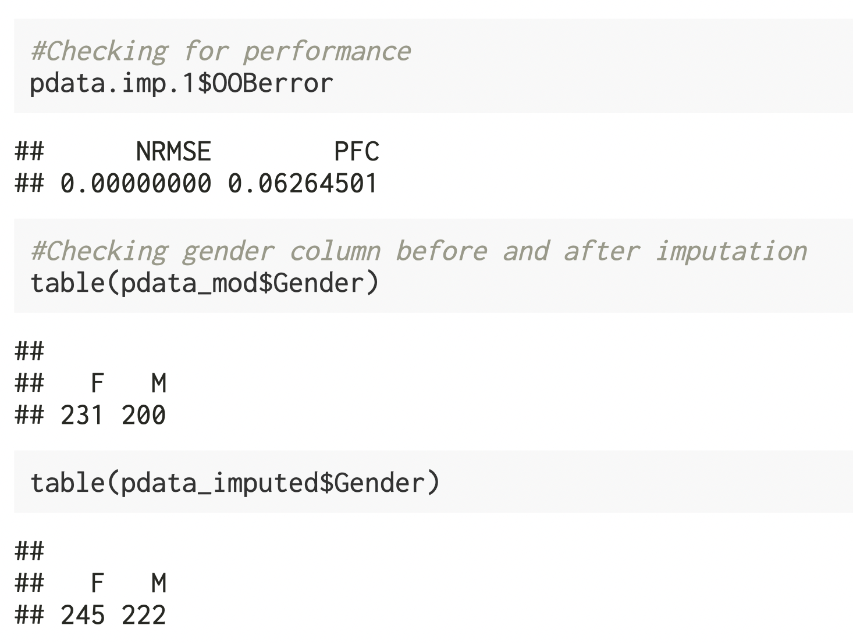
Data Imputation: Results
After imputation, performance is assessed using the normalized root mean squared error for the continuous variables and proportion of falsely classified entries for categorical variables.
In both cases, good performance leads to a value close to 0 and bad performance to a value around 1.

Slide 12
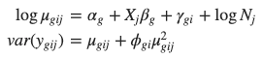
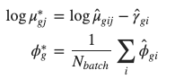
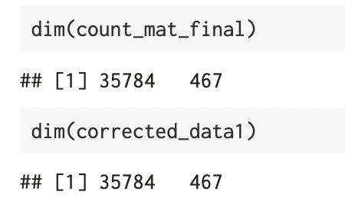
Batch correction using Combat_seq
ComBat_seq is an improved model from ComBat using negative binomial regression, which specifically targets RNA-Seq count data.
ComBat-seq takes untransformed, raw count matrix as input.
Same as ComBat, it requires a known batch variable.

Slide 13
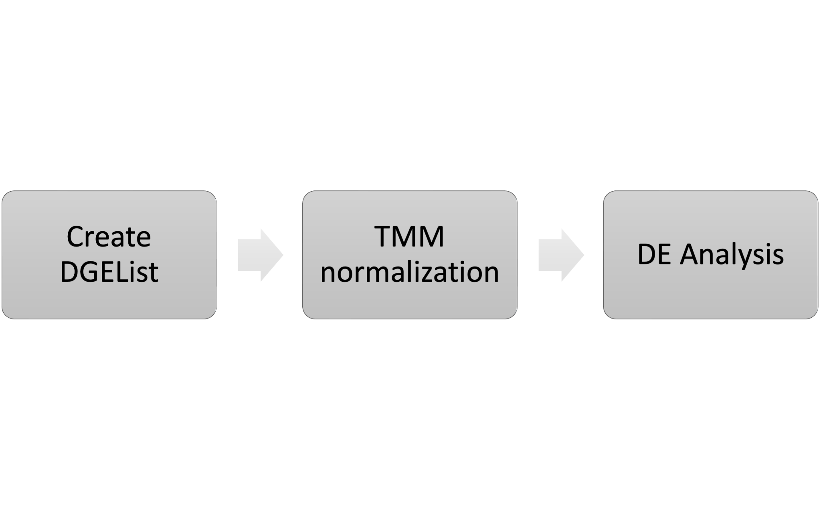
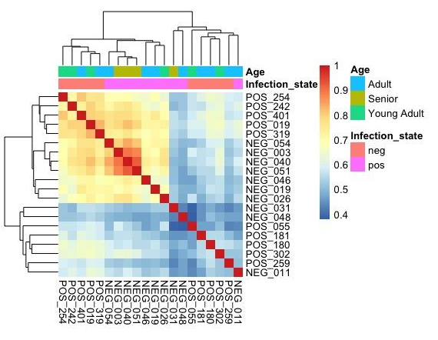
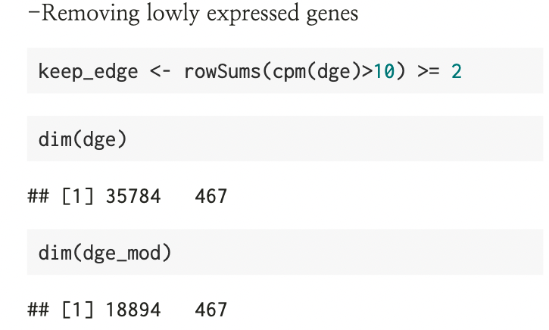
Assessing overall trends

Slide 14
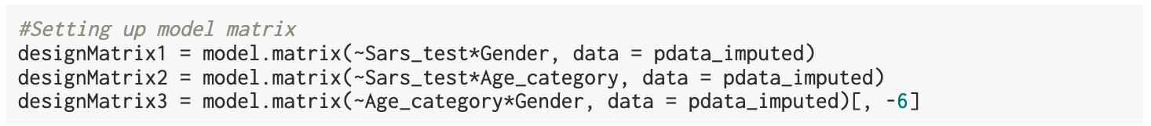
Differential expression analysis using EdgeR
Interaction terms used: Sars_test*sex; Sars_test*Age category; Age category*Sex
Estimating dispersion and fitting to a generalized linear model
Example: Interaction between Sars_test and Sex

Slide 15
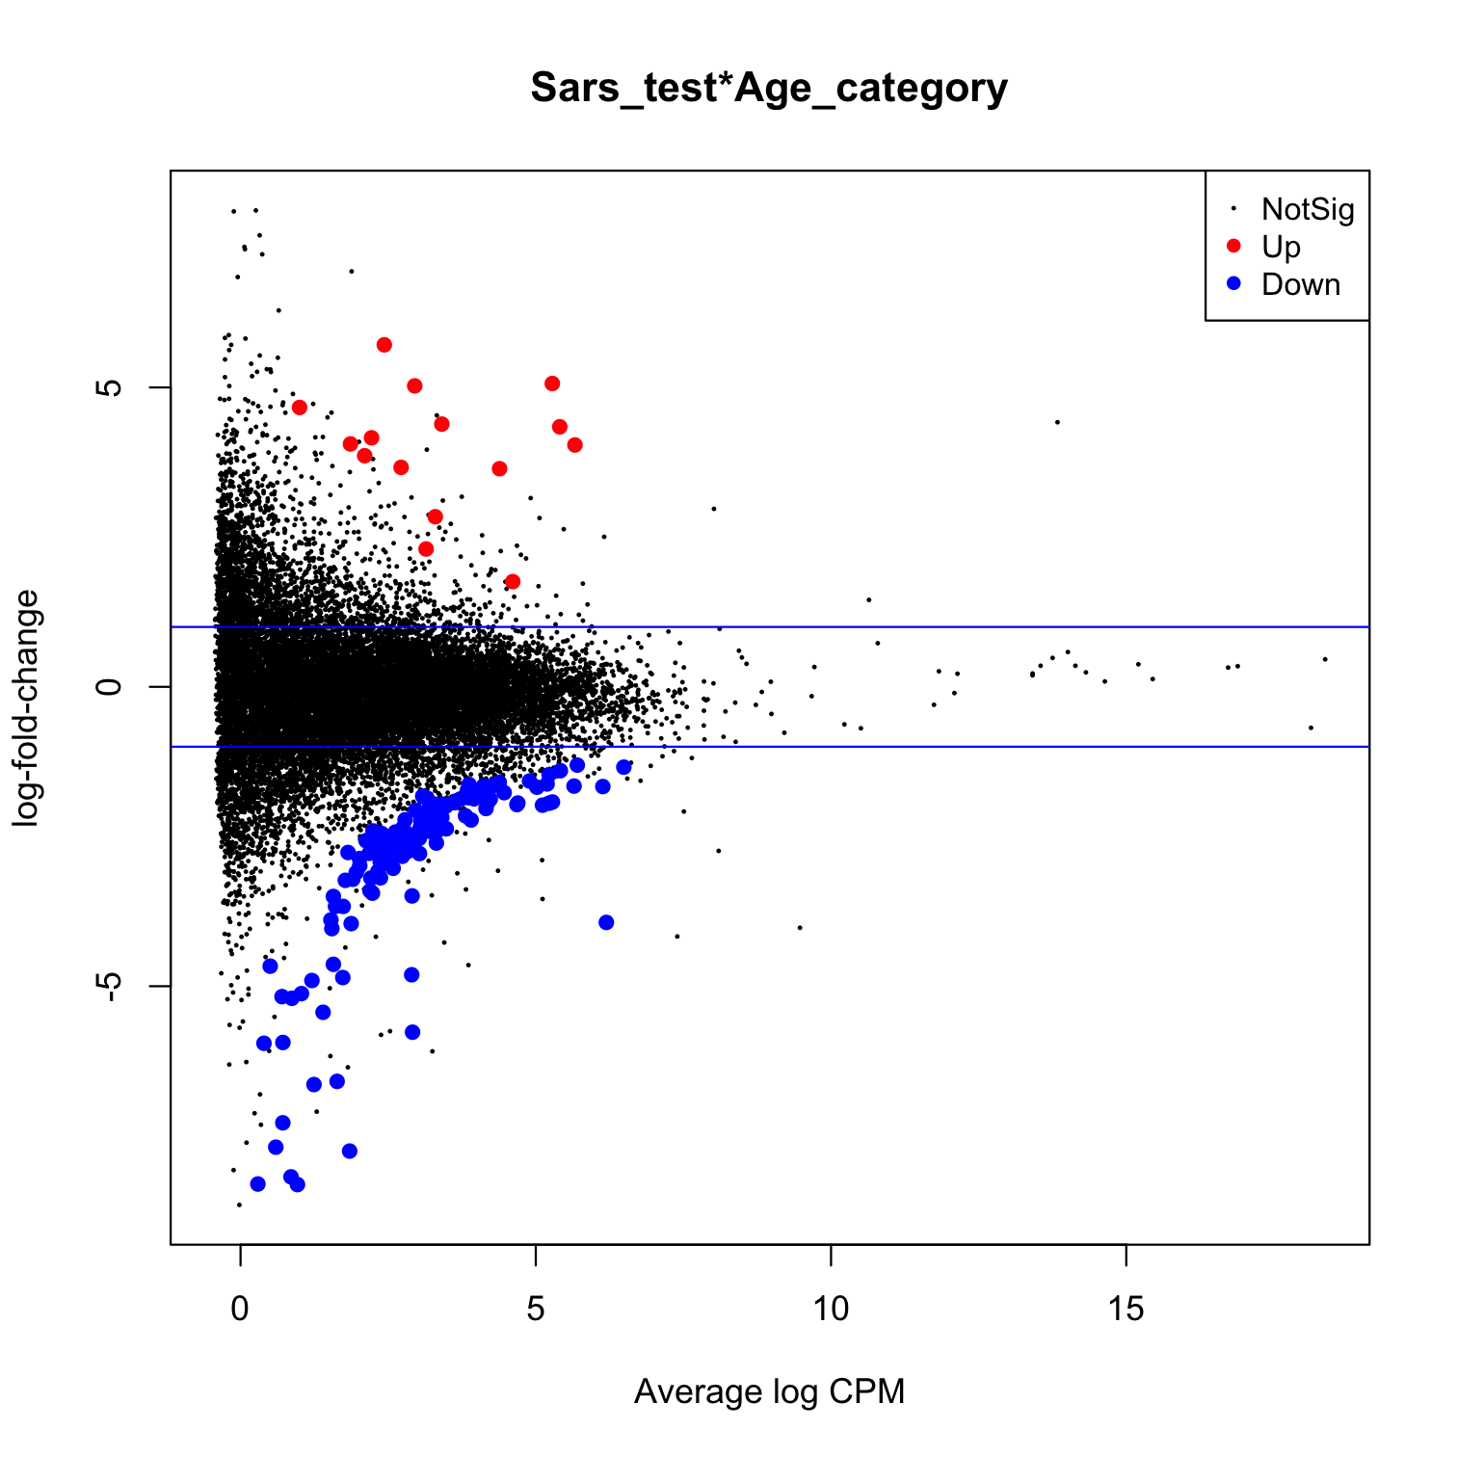
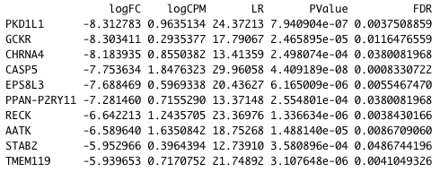
Interaction between Infection status and Age
Cutoff: p.value = 0.05, logFC = |1|
Down | 126
NotSig | 18753
Up | 15

Slide 16
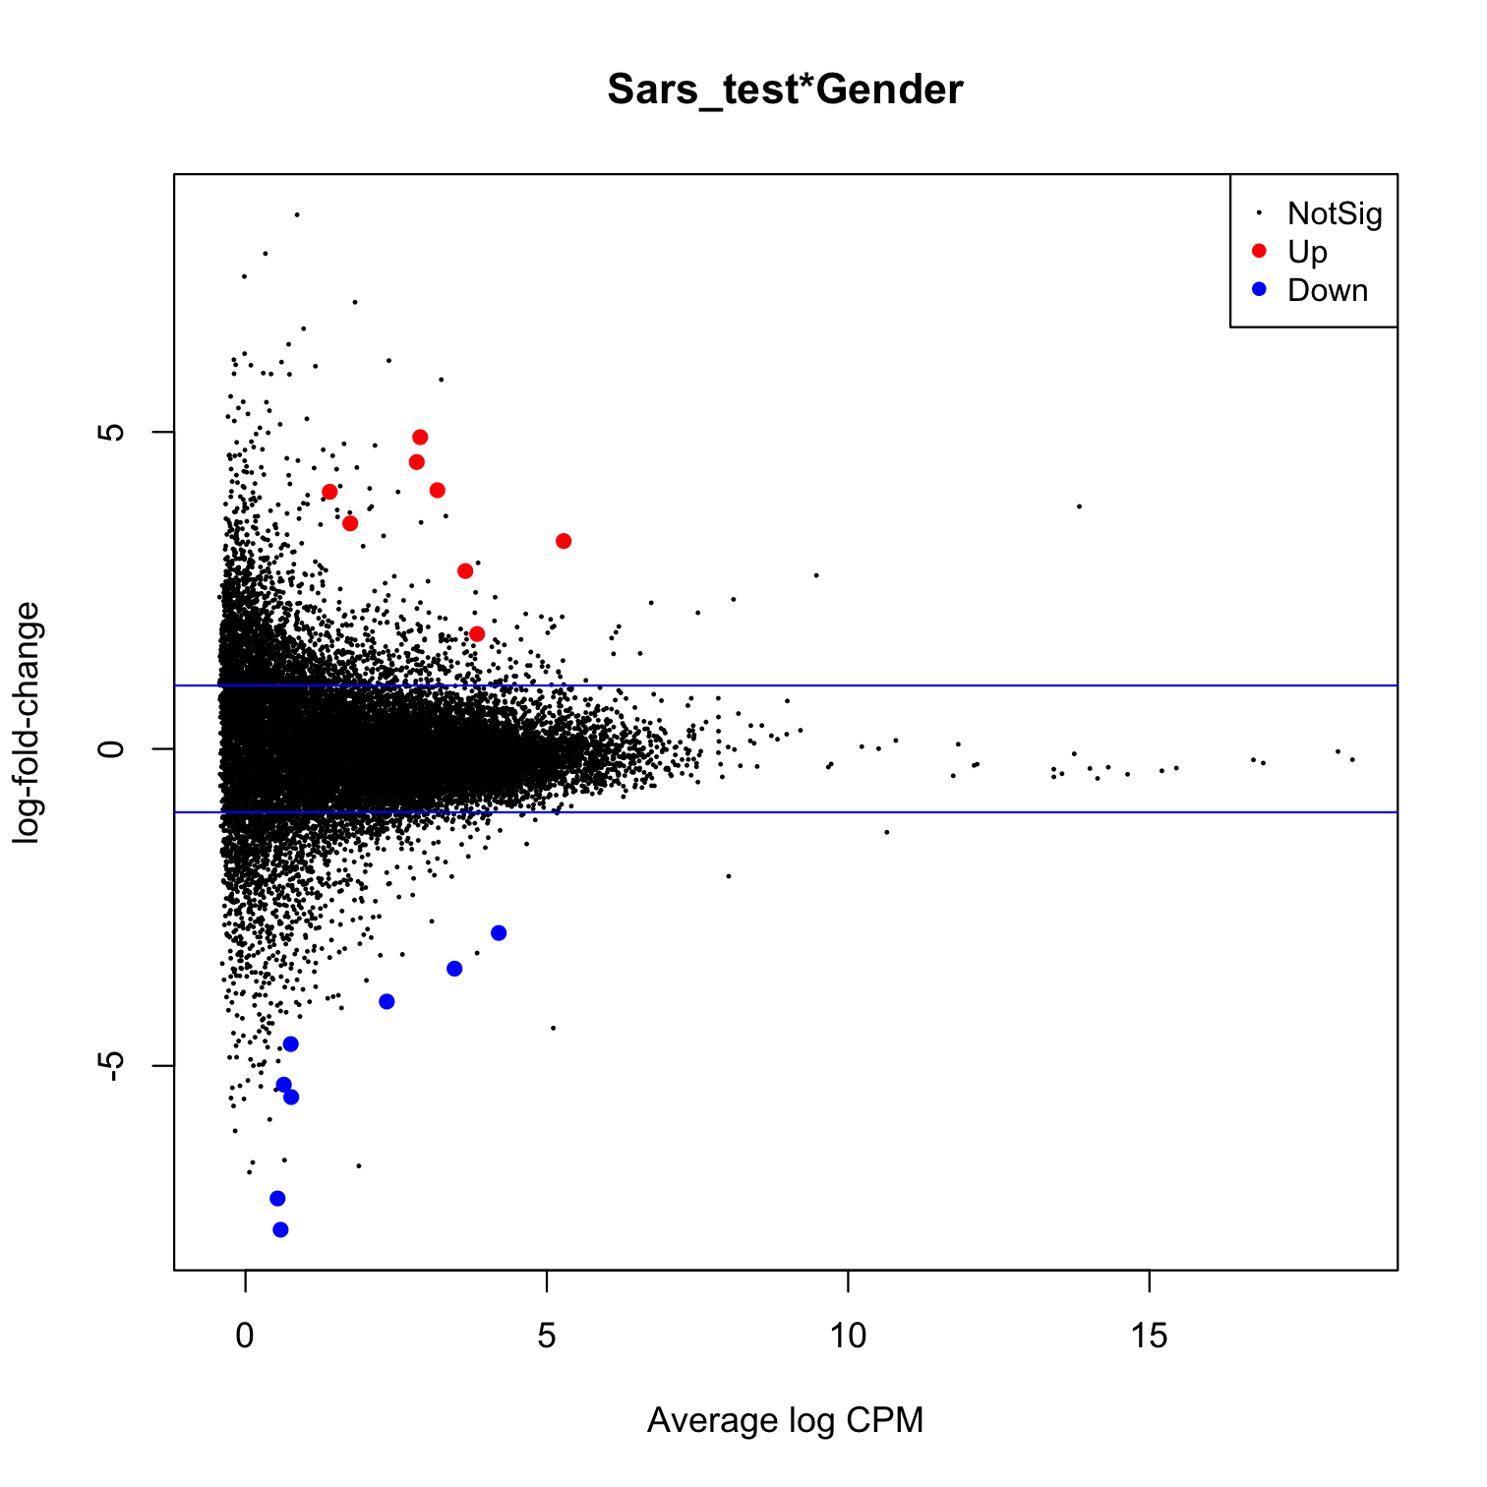
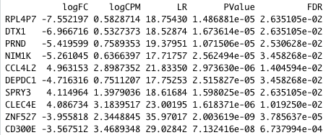
Interaction between Infection status and Gender
Cutoff: p.value = 0.05, logFC = |1|
Down | 8
NotSig | 18879
Up | 7

Slide 17
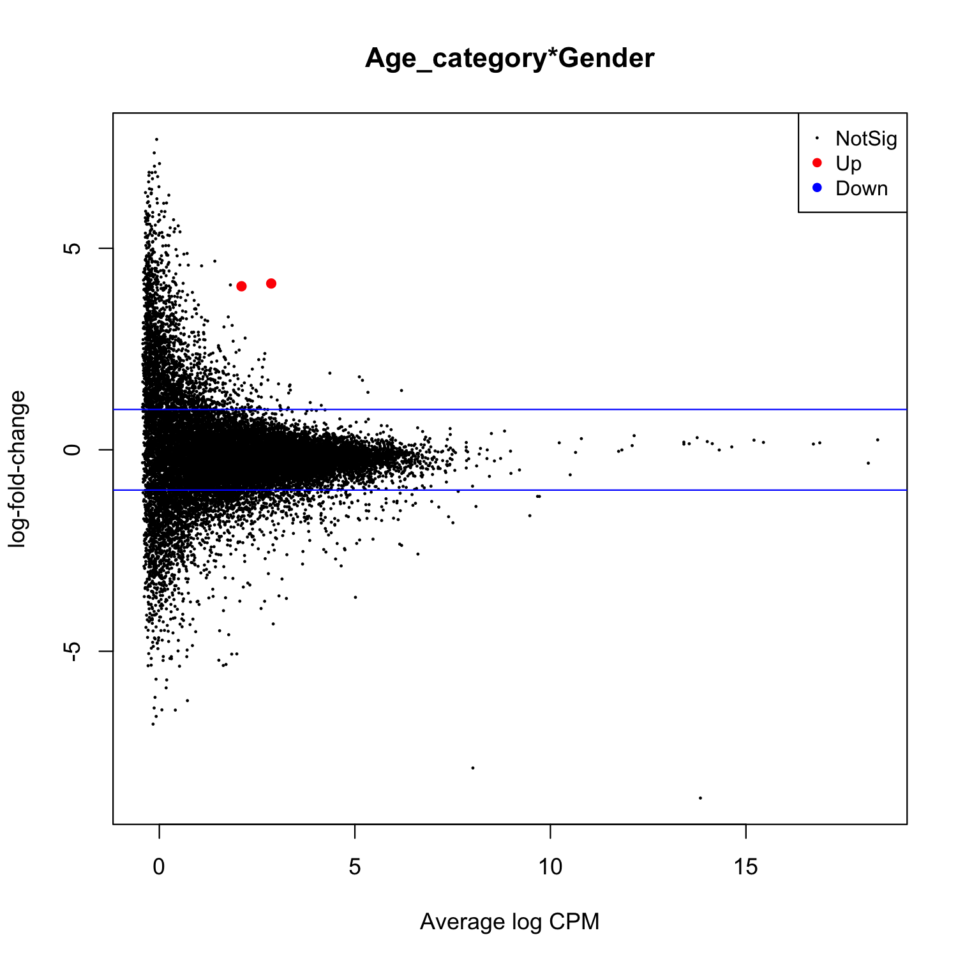
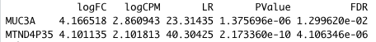
Interaction between Age and Gender
Cutoff:p.value = 0.05, logFC = |1|
Down | 0
NotSig | 18892
Up | 2

Slide 18
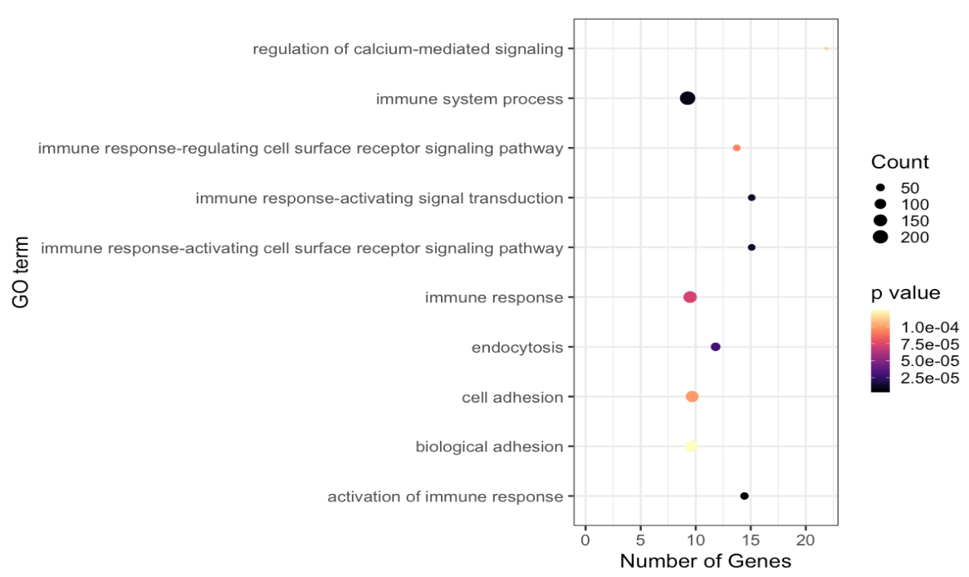
GO Analysis
Enriched Gene Ontology terms for top differentially expressed genes by infection status and sex

Slide 19
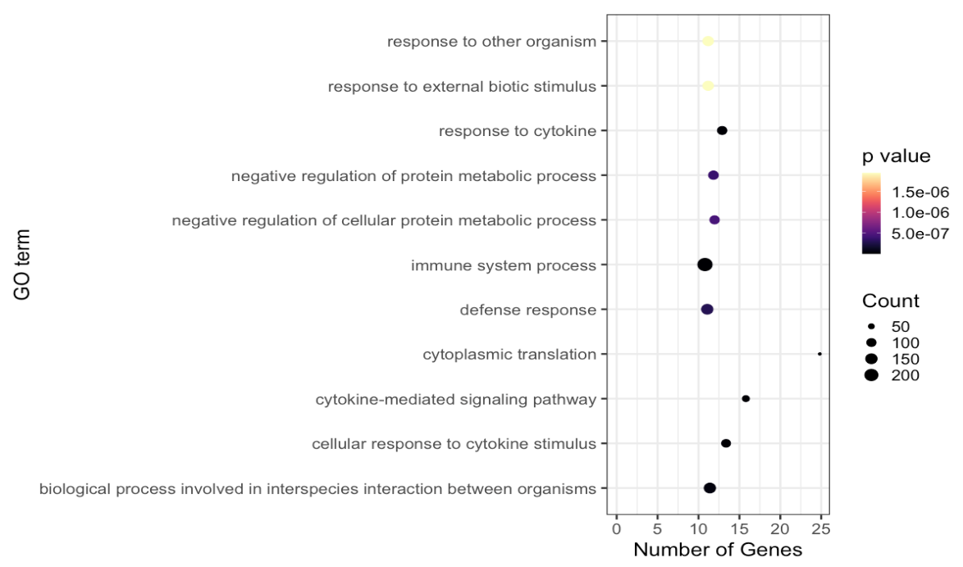
GO Analysis
Enriched Gene Ontology terms for top differentially expressed genes by infection status and age group

Slide 20
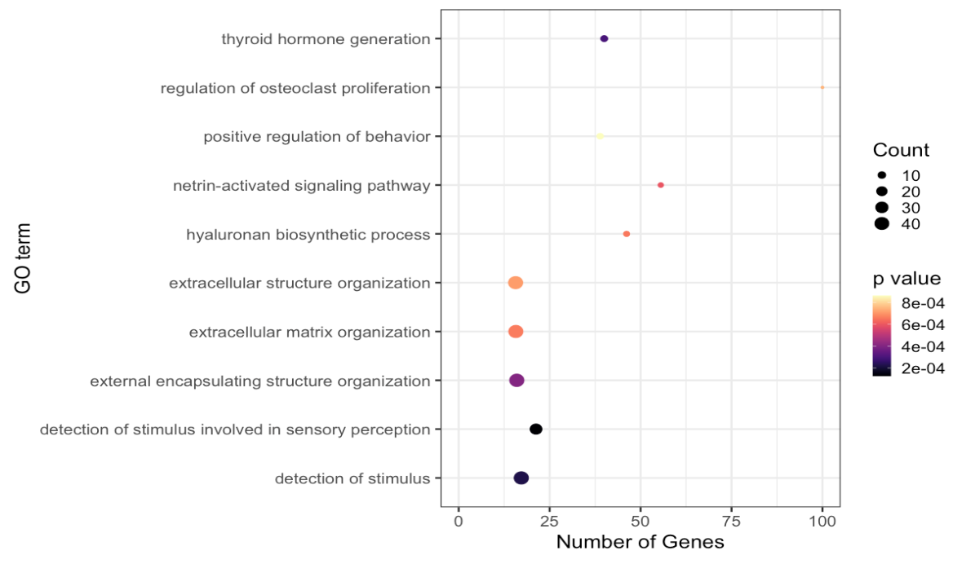
GO Analysis
Enriched Gene Ontology terms for top differentially expressed genes by age and sex

Slide 21
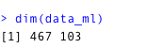
Machine learning analysis
Given transcriptomic data, can we predict if a patient has COVID-19?
We used the top 100 genes that were differentially expressed from design matrix 3 (age:gender)
Manipulated the data frame to have:
Rows: samples
Columns: Metadata (age, gender, infection status, 100 genes)
Models used:
K Nearest Neighbors
Logistic regression

Slide 22

K Nearest Neighbors
Non-parametric supervised learning method
Could be used for both classification and regression
Data is projected in a multidimensional feature space
Label for unknown data point is assigned based on the k-nearest neighbors
Based on Euclidean distance

Slide 23
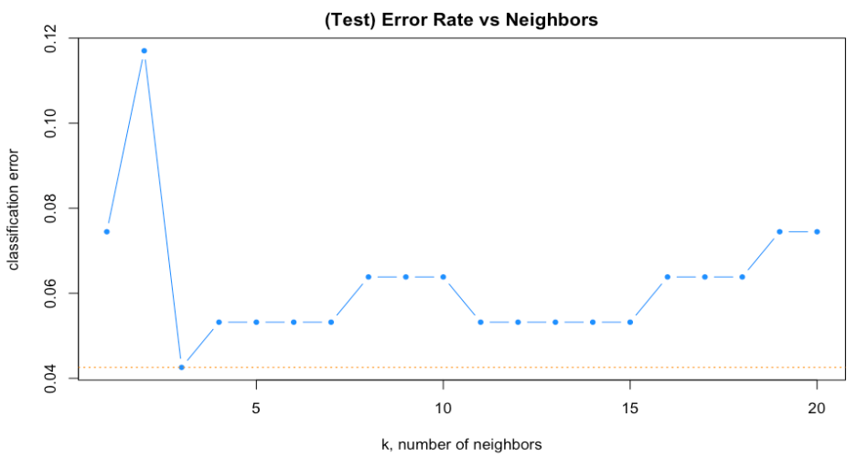
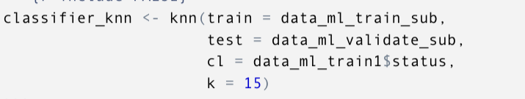
Tuning of k

Slide 24
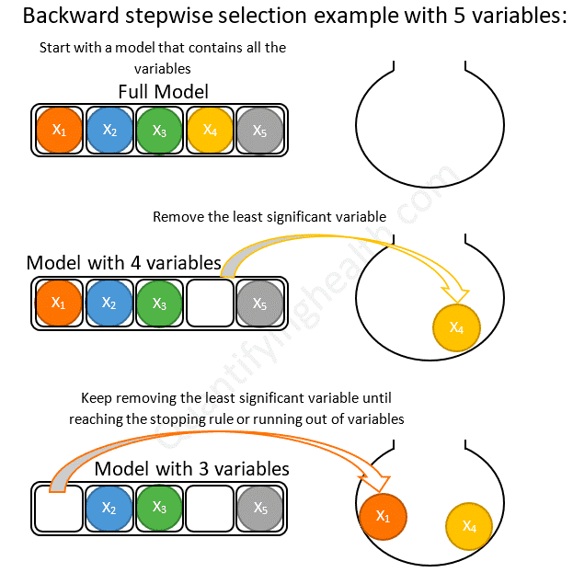
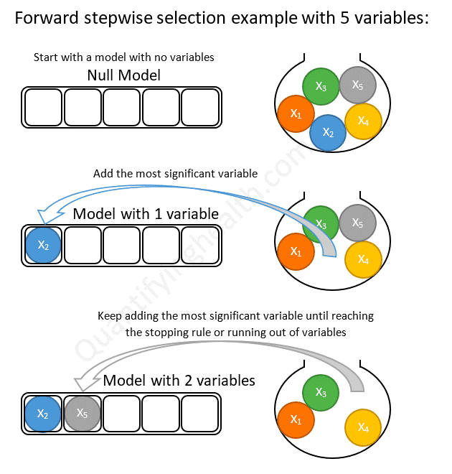
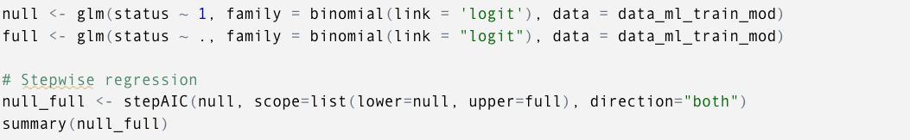
Logistic Regression
Assigns a probability of a unknown sample belonging to either class (positive or negative)
Performed a feature selection analysis using stepwise logistic regression

Slide 25
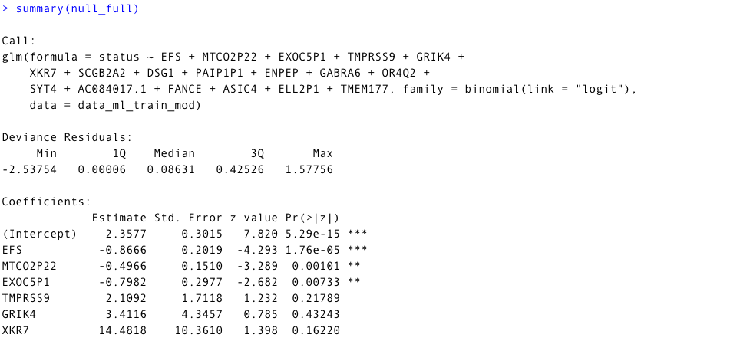
Logistic Regression model

Slide 26
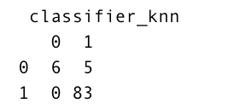
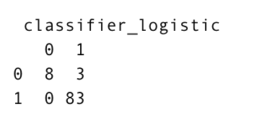
Machine learning results
KNN
Logistic regression
 | Sensitivity | Specificity | Accuracy
KNN | 0.943 | 1.00 | 0.947
Logistic regression | 0.965 | 1.00 | 0.968

Slide 27
Conclusions
We found slight differences between the two patient groups
As shown, we were able to:
identify genes related to immune response using Gene Ontology enrichment analysis
Develop a ML model to predict infection status
Future work
Biological mechanisms of why our ML model works
Pathway analysis
Detailed Gene Ontology analysis
Predictive gene signature of SARS-Cov2

Slide 28
Thank you!
Questions

